Slide 1
MUMBAI – GUJARAT – BANGLORE – KERALA – CHENNAI - BANARAS
THE MUMBAI CRICKET CLUB
GRC AT ITS BEST
DOMES, WINDOW ARCHES, CORNICES , COLUMNS & OTHER ARCHITECTURAL FEATURES

Slide 2
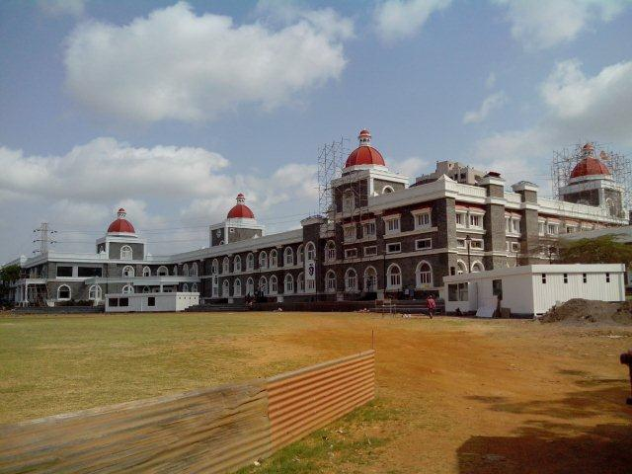
THE CLUB HOUSE

Slide 3
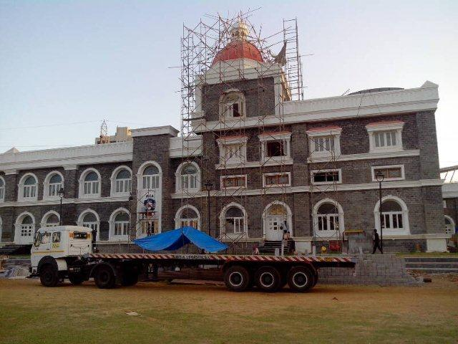
GRC FEATURES IN WHITE

Slide 4
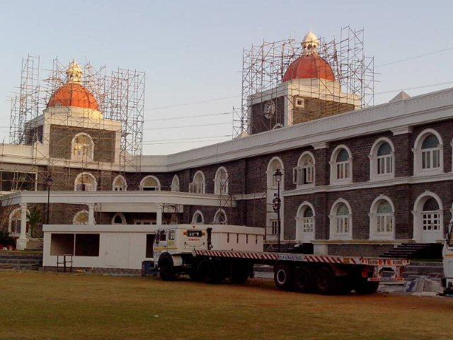
THE GRC DOME
(PRE PIGMENTED)

Slide 5
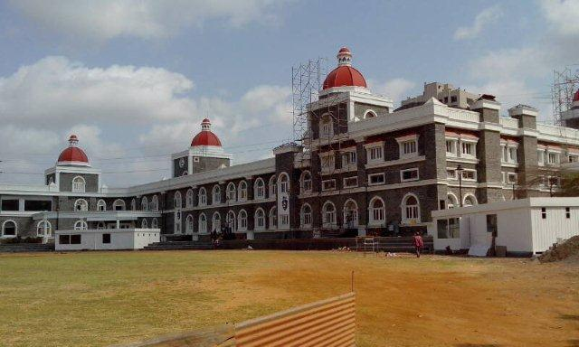
EXTERIORS
WOULD LOOK INCOMPLETE WITHOUT GRC

Slide 6
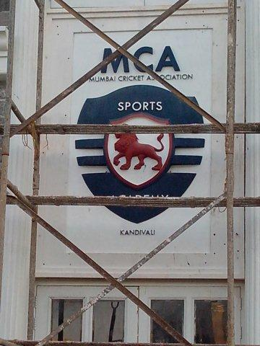
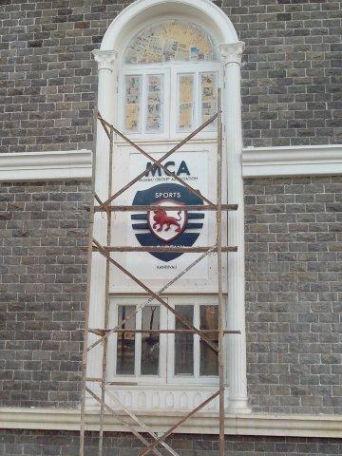
THE LOGO ALSO CRAFTED IN GRC

Slide 7
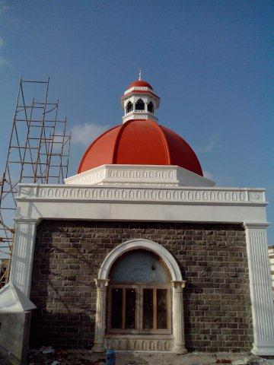
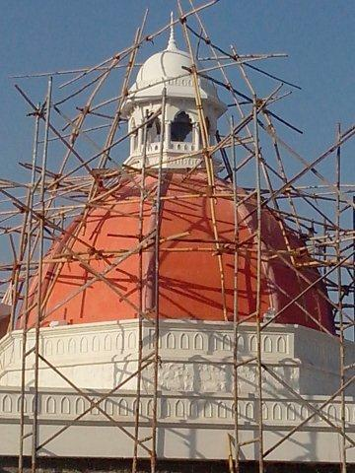
DOME & ITS FEATURES

Slide 8
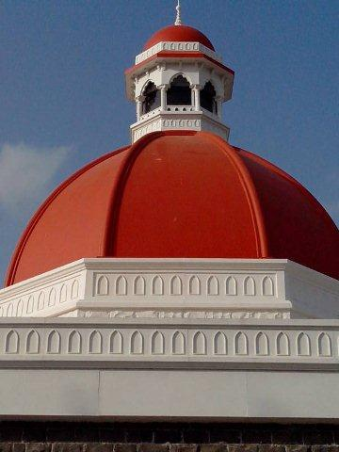
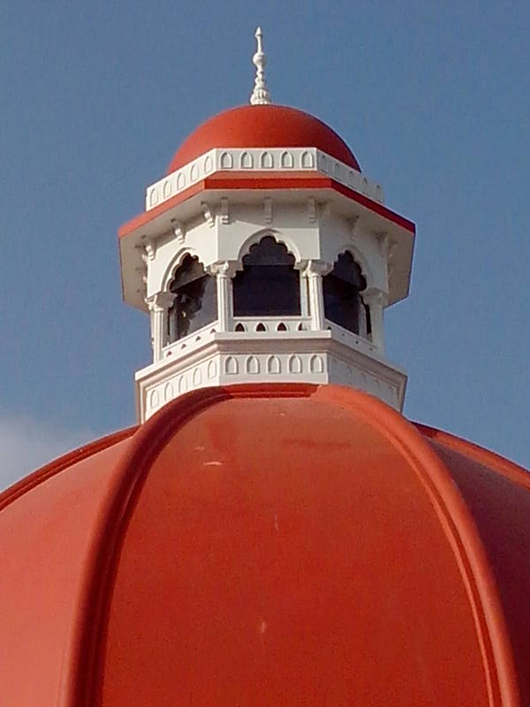
DOME & ITS FEATURES

Slide 9
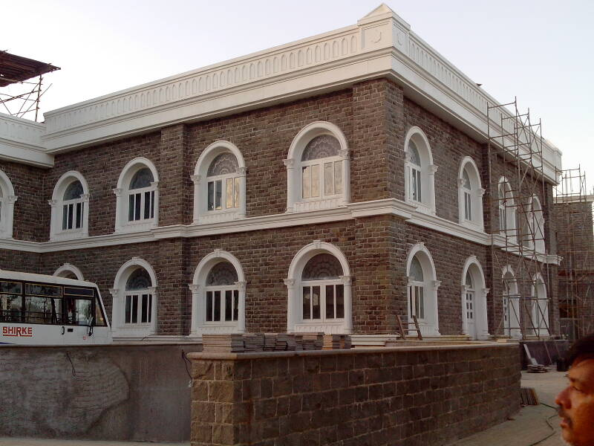
THE TOP BAND

Slide 10
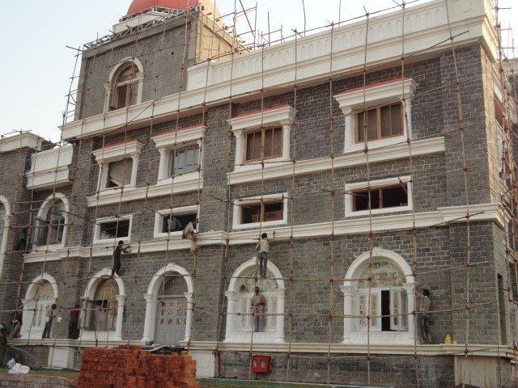
WINDOW SURROUNDS

Slide 11
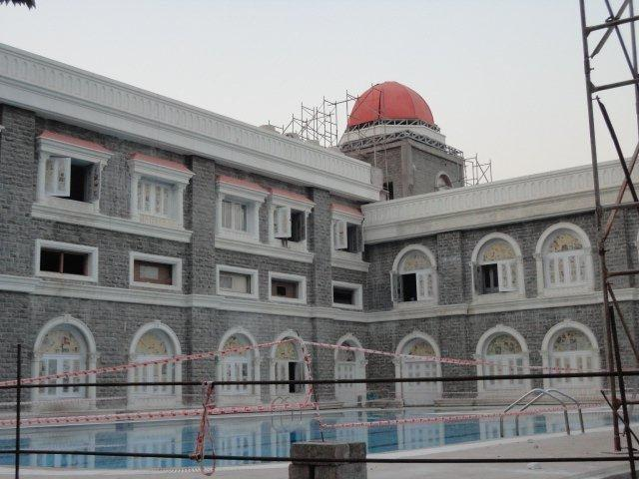
THE POOL SIDE CORNER SURROUNDS

Slide 12
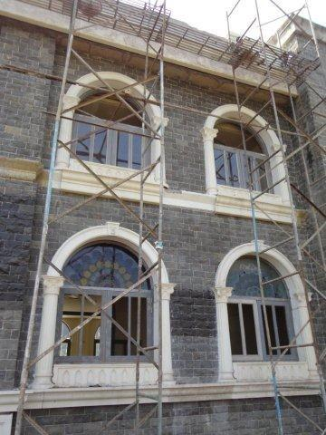
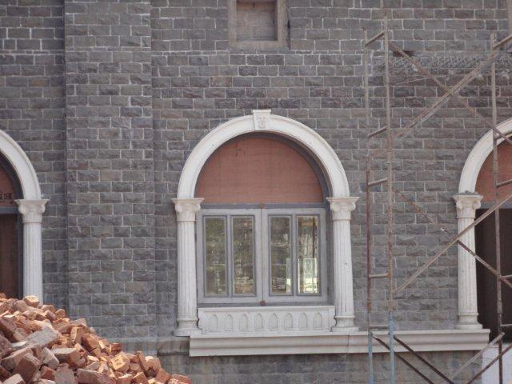
THE ARCH WIRG COLUMNS

Slide 13
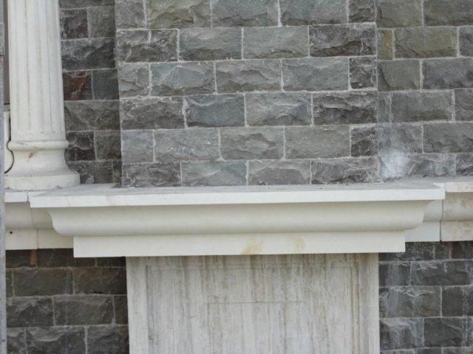
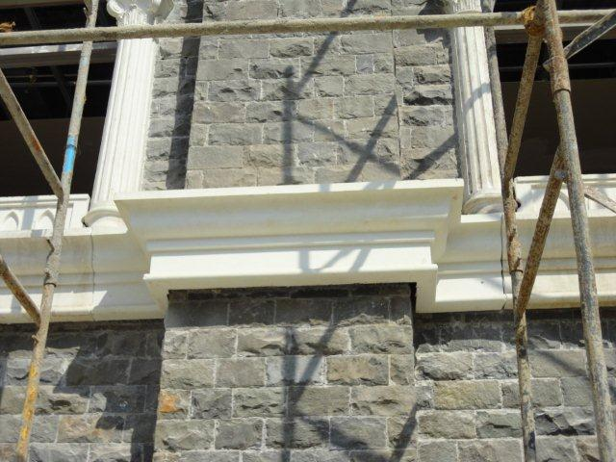
ONE PIECE
CORNER CORNICE FOR BETTER FINISH

Slide 14
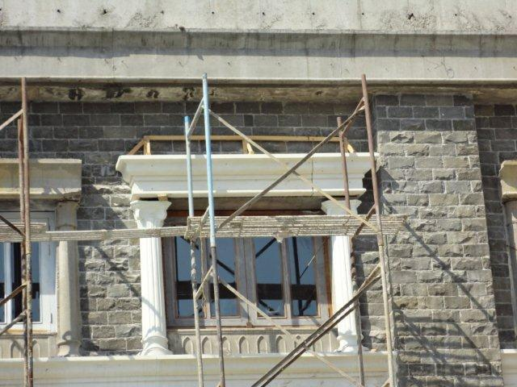
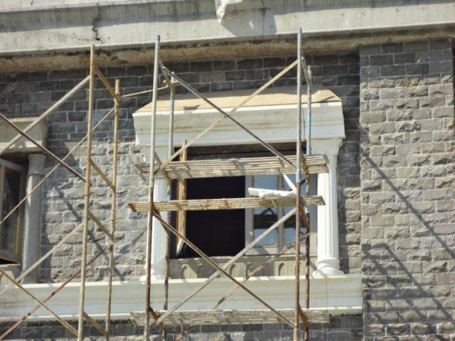
THE CORNICE WITH COLUMNS

Slide 15
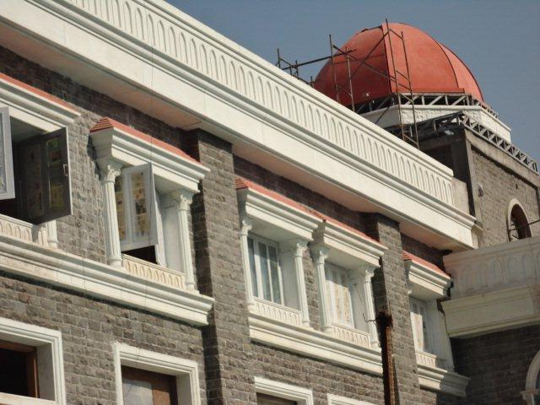
THE DECORATIVE BAND WITH CORNICE

Slide 16
CONTACT DETAILS
GFRC FACADES.
GFRC / GRC, GRG CEILINGS & PANELS, FRP WORKS, HIGH END DECORATIVE & ARCHITECTURAL WORKS & ACOUSTIC SOLUTIONS WITH EXPERTISE IN HOME THEATRES
SRIHARI NILKAR
MUMBAI
Mobile: 09867569395
nilkarsrihari@gmail.com

